Slide 1
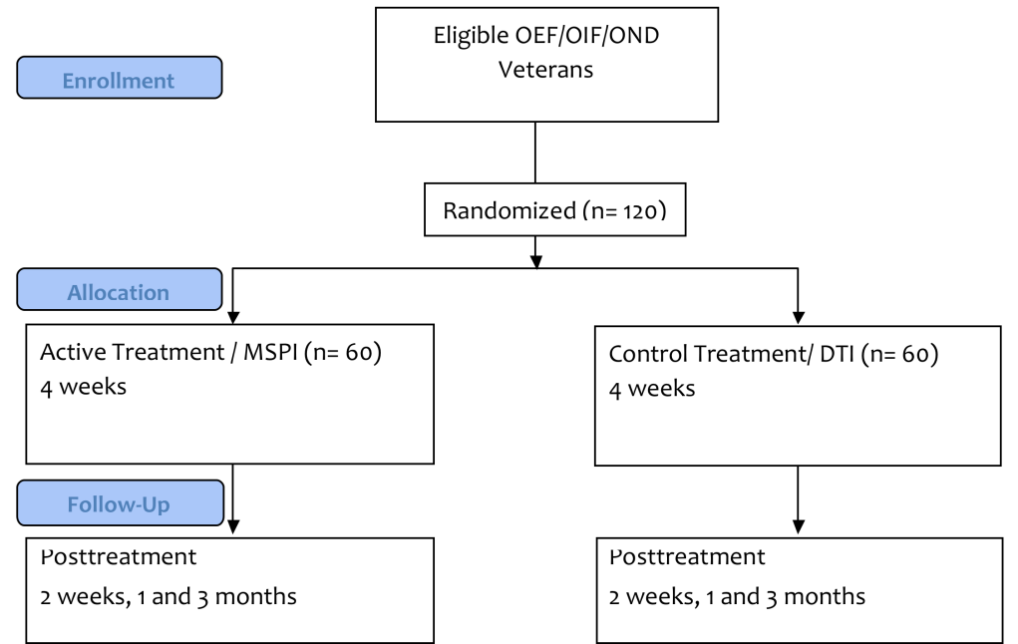
Military Suicide Research Consortium: Current Funded Studies Jetta Hanson, M.A., Megan Dwyer, B.S., Kelly Moroney, M.A.,
James Pease, M.S.W., & Peter M. Gutierrez, Ph.D.
VISN 19 Mental Illness Research, Education, and Clinical Center (MIRECC) and
Military Suicide Research Consortium
What is the Military Suicide Research Consortium (MSRC)?
Suicide in the military has risen dramatically in recent years. In order to address this growing concern, the Department of Defense awarded $17 million to the Military Suicide Research Consortium (MSRC). The funding was split between two sites, Florida State University and VISN 19 MIRECC. The Consortium is designed to fund innovative research projects in the areas of suicide prevention among active-duty military members and Veterans. In particular, research related to suicide risk screening, assessment, prevention efforts, and interventions were given the highest priority. Within the first year of funding the MSRC chose seven studies to fund, of which four are funded out of the Denver site. This poster contains the descriptions of the studies funded by the Denver site. If you would like to know more about the MSRC structure please visit Kelly Moroney’s poster titled The Military Suicide Research Consortium: An Infrastructure Improving Mental Health Outcomes for Active Duty Military, Veterans and Civilians.
Window to Hope: Evaluating a Psychological Treatment for Hopelessness among
Veterans with Traumatic Brain Injury
PI: Lisa Brenner, Ph.D.
Type of Study: Intervention/ Treatment
Methodology: Randomized Controlled Trial with a Cross Over Condition
Overview: This study is focused on addressing two challenges that the Military is currently facing which are increased suicide and traumatic brain injuries (TBIs). The aim of this study is to adapt and validate the Window to Hope (WtoH) as an effective suicide treatment/intervention for US military personnel and Veterans. The WtoH was developed by Dr. Graham Simpson, using principals from Cognitive Behavioral Therapy (CBT) and structuring the treatment on four core therapeutic strategies: behavioral activation, cognitive restructuring, problem solving and relapse prevention. The feeling of hopelessness is the main target of this intervention. Participants will be randomly allocated into a treatment group or waitlist group. The treatment group will complete the WtoH. The waitlist group will receive enhanced treatment as usual (ETAU). This study does include a cross-over condition which will allow participants allocated to the waitlist to be offered the treatment later in the study.
A Behavioral Sleep Intervention for the Prevention of Suicidal Behaviors in Military Veterans: A Randomized Controlled Trial
PI: Rebecca Bernert, Ph.D.
Type of Study: Intervention
Methodology: Randomized Controlled trial
Overview: The aim of this study is to manualize an integrated sleep intervention to decrease suicidal behaviors among Operation Enduring Freedom (OEF) and Operation Iraqi Freedom (OIF) Veterans. It will test the outcomes of a Military Sleep-based Preventive Intervention (MSPI) using a randomized controlled trial. Participants will attend 8 study visits, post treatment, as well as a 1 month and 3 month follow up. After initial screening, participants will be randomized to either MSPI or Treatment as Usual (TAU). MSPI consists of modified version of Cognitive Behavioral Therapy for Insomnia. The main areas of focus for this treatment are sleeping behavior, cognitive restructuring, relaxation training, nightmare frequency and severity, and stimulus control techniques. At each visit, data will be collected from a sleep diary as well as empirically supported assessments.
General Information about the studies
Populations being studied:
Veterans
US Military Personnel
Family members of Veterans and US military personnel
(with exception of children under 18)
Study Sites:
The studies are being conducted at numerous VA and Military installations across the country.
Common Data Elements:
As a requirement to receive funding from the MSRC every study must have participants fill out a 57 item assessment that was put together by the MSRC.
Usability and Utility of a Virtual Hope Box (VHB) for Reducing Suicidal Ideation
PI: Nigel Bush, Ph.D.
Type of Study: Intervention
Methodology: Mix Method
Overview: A common strategy to cope with suicidal ideation and behavior is the creation of a Hope Box which usually consists of items that are life-affirming. A limiting aspect of a traditional “physical” Hope Box (PHB) is the lack of portability. A simple solution is to make a Virtual Hope Box (VHB) for Smartphones. A VHB turns the PHB into an application that can be accessed at anytime, anywhere. The VHB will provide users with stress management tools, interpersonal support (voice or video memos), inspirational texts, and life affirming reminders. After the VHB has been developed and the usability tested, the VHB will be compared to the traditional PHB. Participants will be randomized to start with either the PHB or the VHB. After a set period of time the participant will return to the clinic to evaluate the Hope Box they were using and then be switched to the other condition. Electronic VHB usage, self reports of PHB and VHB usage, brief patient usability and user satisfaction measures of both Hope Boxes will be collected. A follow up assessment will also be given to compare to the baseline.
Suicide Bereavement in Military and their Families
PI: Julie Cerel, Ph.D.
Type of study: Epidemiological/Postvention
Methodology: Mixed Method
Overview: As a direct result of increased rates of suicide, there are more individuals being exposed to suicide. The outcomes of exposure to suicide have been documented, and may include prolonged grief, PTSD and depression in individuals impacted by suicide. Despite having this knowledge very little is known about how many people in the Veteran or military family population are impacted by suicide, the extent of resulting problems experienced by survivors and which variables could predict negative outcomes in hopes of reducing mortality and morbidity among this population. This study plans to gather epidemiological data to determine how common the experience of exposure to suicide is for Veterans and the relationship between exposure and negative outcomes. This data will be collected in three stages the first being a phone interview. After the initial phone survey individuals who have been exposed to suicide or combat related death of a coworker will be invited to take an online survey. The last stage involves an in depth interview in person or on the phone. Each stage of the study will involve measures targeting suicide, mental health, resilience and posttraumatic growth. An additional component of this study is to meet with adult children, parents, and spouses who have experienced the suicide (in the last five years) of an active duty military member or Veteran. All of the data collected above will be compared to a base group with suicide exposure.
Epidemiological phone study of veterans (n=2000 completed interviews)
Online Survey: Suicide Exposed; n=200
Interview of Suicide Exposed;
n= up to 50
Online Survey: Sudden Traumatic Death of Military Colleague; n=200.
Interview of Sudden Death of Military Colleague; n=up to 50.
Online Survey No Exposure ; n=200.
This presentation is based on work supported by the Department of Defense and VISN 19 MIRECC, but does not necessarily represent the views of the Department of Defense , Department of Veterans Affairs, or the United States Government.

