Slide 1
Development and Evaluation of a Virtual Hope Box for Reducing Suicidal Ideation PI: Nigel Bush, PhD T2: Julie Kinn PhD, Matt Higgins, Wes Turney-Loos VA National Ctr. for PTSD :Julia Hoffman PhD VAMC Portland: Steven Dobscha MD, Lauren Denneson PhD

Slide 2
Disclaimers
"The opinions or assertions contained herein are the private views of the authors and are not to be construed as official or reflecting the views of the Department of Defense.
“This work was in part supported by the Military Suicide Research Consortium (MSRC), Department of Defense, and VISN 19 Mental Illness Research, Education, and Clinical Center (MIRECC), but does not necessarily represent the views of the Department of Defense, Department of Veterans Affairs, or the United States Government. Support from the MSRC does not necessarily constitute or imply endorsement, sponsorship, or favoring of the study design, analysis, or recommendations.”

Slide 3
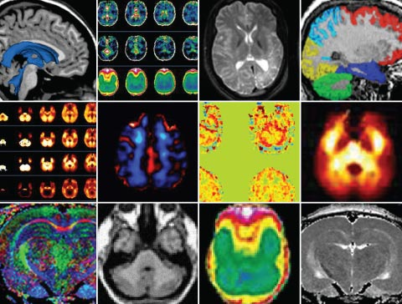
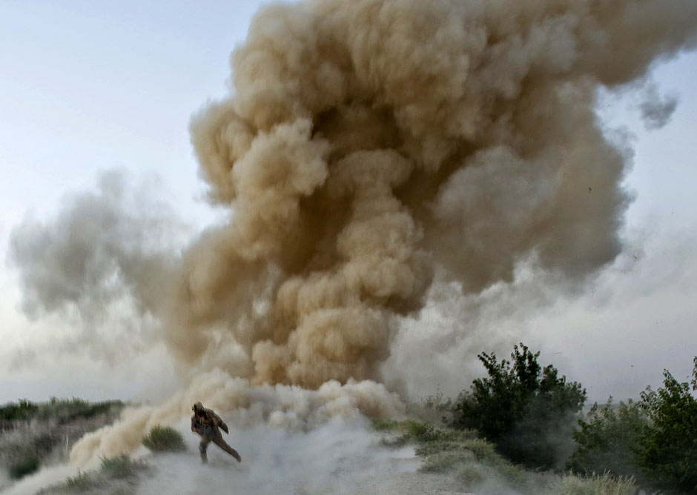
Background
Since 2001, >1.5 million US military service members deployed in support of Operation Enduring Freedom (OEF) and Operation Iraqi Freedom (OIF).
Traumatic Brain Injury
Mental/Behavioral Health Problems
PTSD
Depression
Anxiety
Stress
Family/Social Dysfunction
Suicide
2010 DoD Suicide Event Report
281 suicide completions confirmed
863 attempts by 837 individuals

Slide 4
Suicide Prevention
Cognitive Therapy (CT) & Dialectical Behavior Therapy (DBT):
Suicidal patients are able to cite reasons for wanting to die, but they often find it challenging to think of and believe in reasons for living
CT/DBT teaches patients to identify desired outcomes and modify thoughts and behaviors to increase the likelihood of such outcomes
Aimed at redirecting the distressed individual’s attention towards reasons for living
Combined with stress-reduction techniques - relaxation and distraction
CT/DBT effective in managing suicidal patients
Hope Box or Hope Kit
Common component of CT and DBT
Physical representation of the patient’s reasons for living that the patient creates and customizes
Stores items that a patient can refer to during feelings of hopelessness
E.g. favorite CD, family photographs, reminders of accomplishments and future aspirations, supportive messages from loved ones.

Slide 5
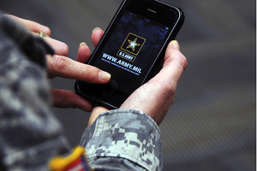
Personal Smartphone Revolution
CDS’s Behavioral Risk Factor Surveillance System (BRFSS) 2009: Personal Cell Phone Use
74% non military
83% active duty service members
77% recent veterans
T2’s PTEC 2010: Personal Cell Phone Use
85% to 93% active duty service members
60% had downloaded free “apps”
Smartphone Apps 2012
>300,000
8,000 health-related
Smartphone Apps for Psychological Health
Approx 5,000 – 10,000
Anxiety, depression, smoking, alcohol use, psychosis, diet, exercise, weight loss, nutrition, parenting, cognitive performance, relationships, relaxation, sleep, spirituality, and general wellbeing.
Army exploring plans to equip all service members with smartphones

Slide 6
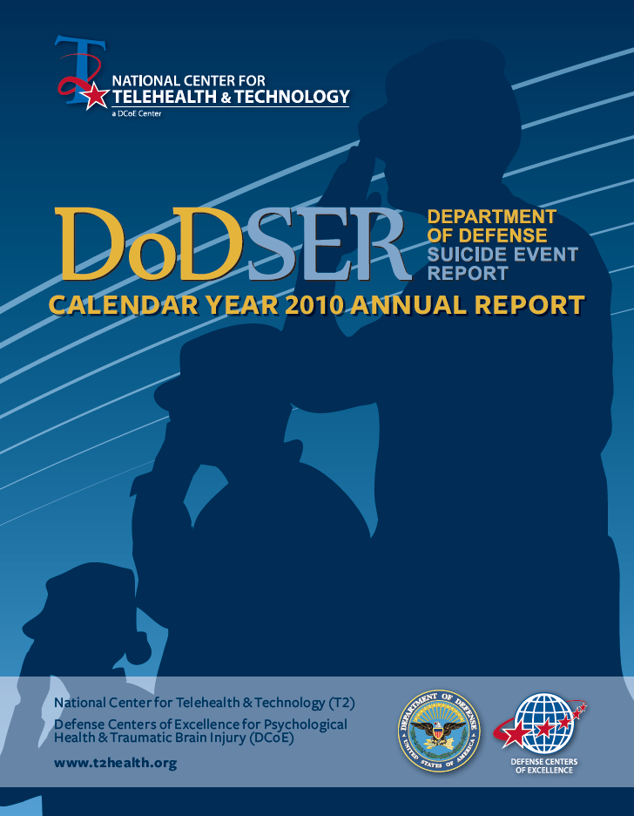
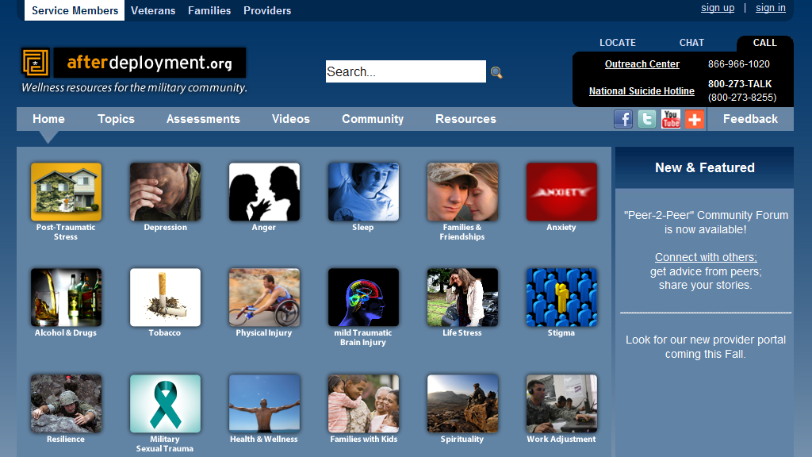
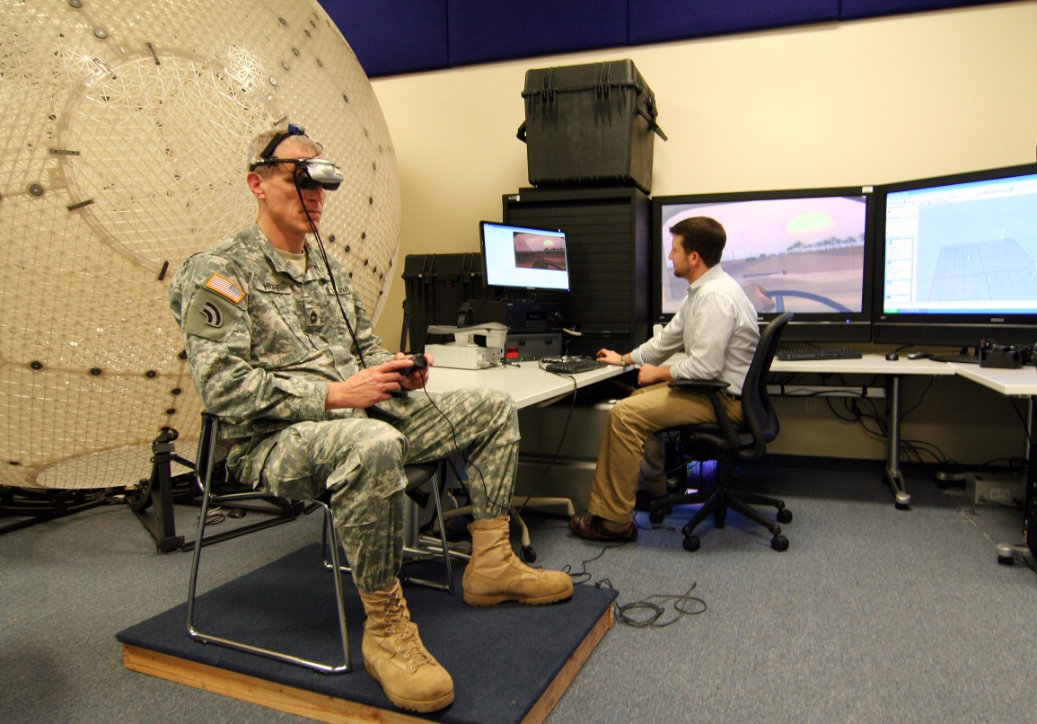
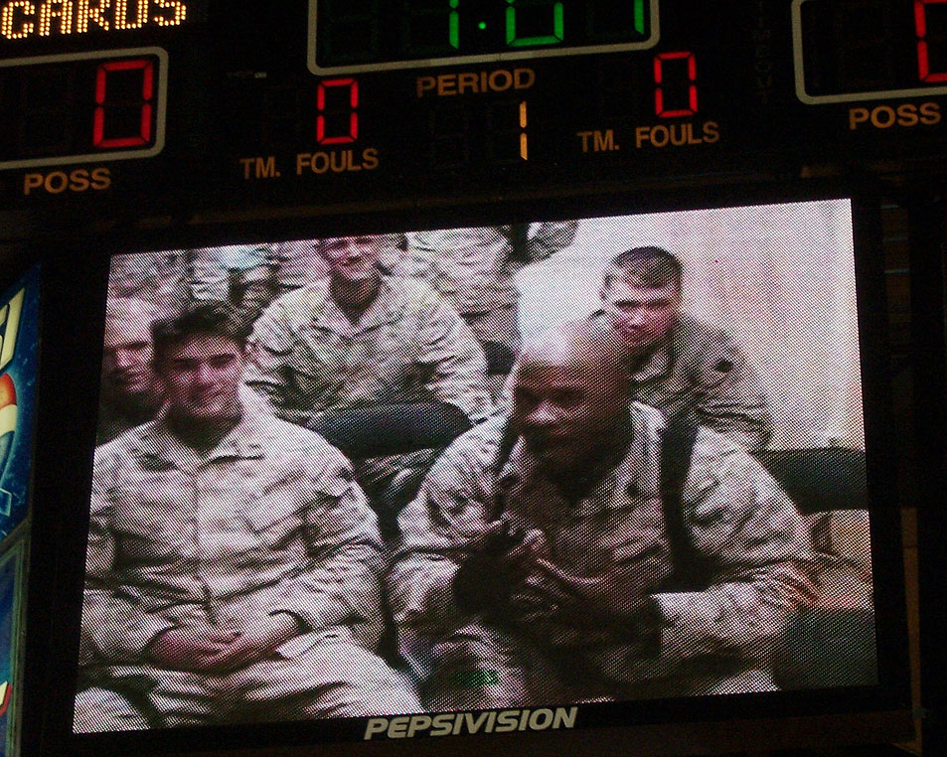
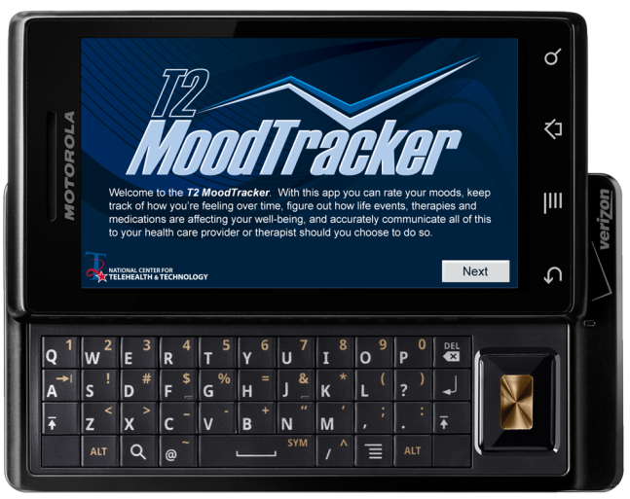
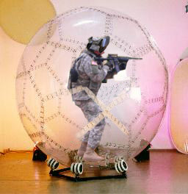
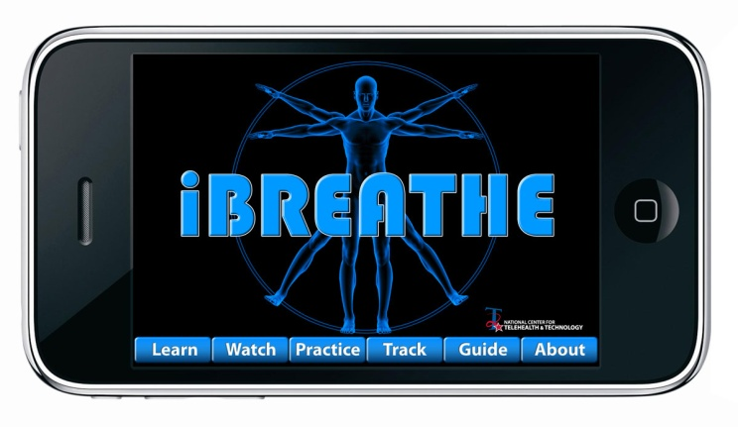
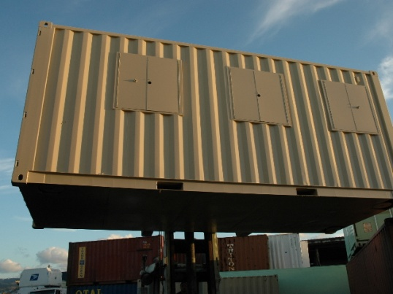
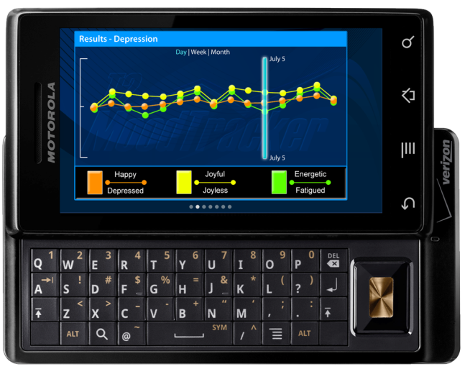
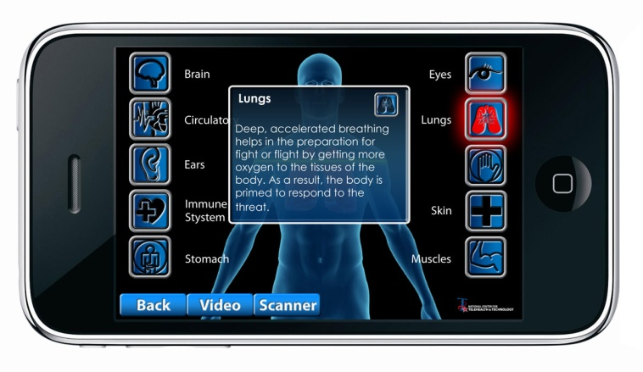
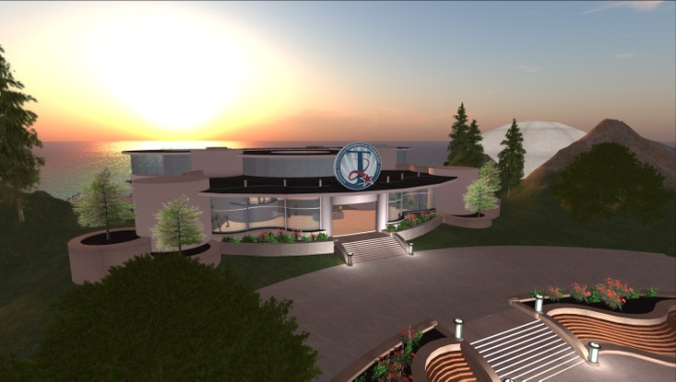
DCoE’s National Center for Telehealth & Technology (T2)
Technology for Military Psychological Health & TBI
Population and Prevention Programs
Innovative Technology Applications
Clinical Telehealth
Website development, surveillance tools, mobile applications
New and innovative technologies, including virtual reality and virtual worlds
Technologies for remote clinical care. Addresses health care access barriers (geography, mobility, and stigma).
Research, Outcomes, Surveillance, Evaluations
8 ongoing suicide research projects

Slide 7
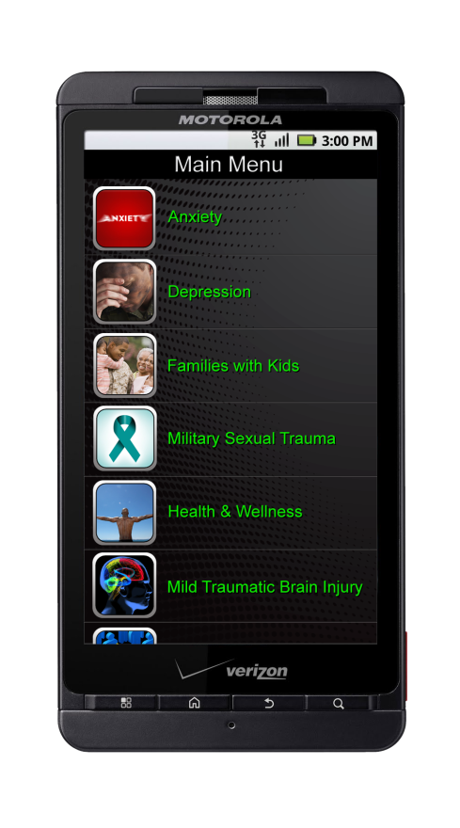
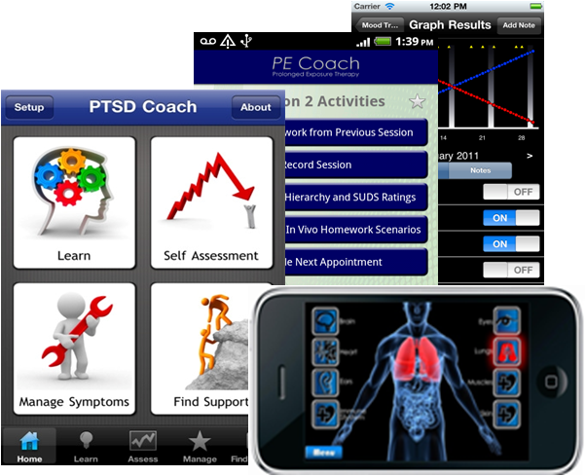
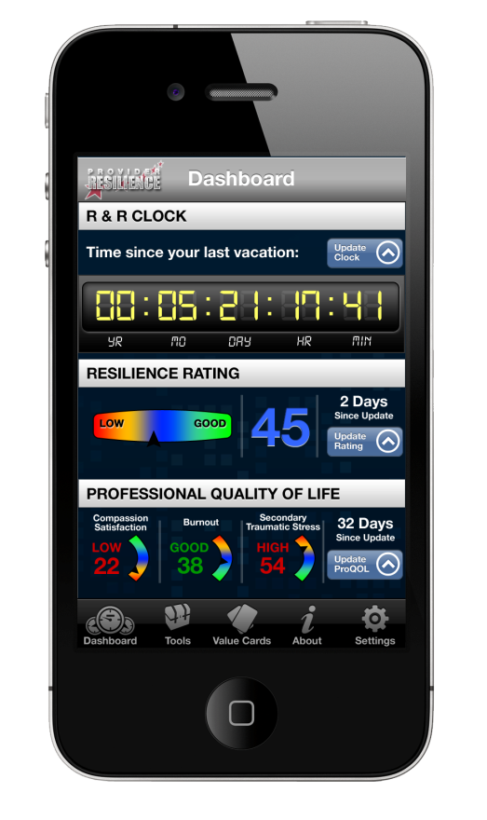
National Center for Telehealth & Technology (DCoE)
Smartphone Apps
At least 27 military psychological health and TBI apps planned, in development, or already publicly available
T2MoodTracker - Enables users to create a personal graphical record of their post-deployment mood changes.
Breathe 2 Relax - Demonstrates and guides deep breathing techniques to reduce stress.
Tactical Breathing Trainer - used to gain control over physiological and psychological responses to stress.
Mobile PE - Allows PTSD patients undergoing prolonged exposure therapy to track the progress of daily homework exercises.
PTSD Coach - an app to provide self-assessment, education, symptom management, and support information, to Veterans and Active Duty personnel (and civilians) who are experiencing symptoms of PTSD.
T2 Mobile Screener - A portable self-assessment screening tool for measuring brief psychological “vital signs” symptoms in the field.
Provider Resilience- An app to track and address provider burnout, compassion fatigue, and secondary traumatic stress
Virtual Hope Box: Create a smartphone app containing essential elements of a hope box and associated components of CT/DBT for military service members and veterans in distress

Slide 8
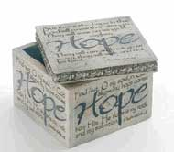
Virtual Hope Box (VHB) App for Smartphones: Rationale
Severe psychological problems leading to hopelessness and even suicide are impacting recently deployed service members and their families
CT & DBT have shown promise in treating suicidality
Therapeutic coping strategies often include use of hope box
Hope box is key therapeutic component but physically unwieldy and inconvenient- often not available when patient needs it most during crises
Rates of personal cellphone use among active and recently retired military personnel are extremely high- ubiquitous
Because mobile devices such as smartphones are carried all the time, they can expand the reach of traditional therapeutic interventions
A “Virtual Hope Box” (VHB) takes the common hope box practice and uses smartphone vehicle and features to enhance the access and experience.
Rich multimedia options on smartphone allow more varied options. Furthermore, smartphones are already common repository for user-generated and user-preferred media.
Service members are highly mobile. Suicidal crises most likely to emerge in absence of healthcare providers.
Smartphone-based app allows for easily personalized VHB that is highly portable and always available to a user in distress wherever they are.

Slide 9
VHB Study
Objective: To conduct a proof of concept development and evaluation of a virtual hope-box (VHB) smartphone app to supplement in-person clinical therapy for service members with suicide ideation or behavior.
We will develop and test the VHB app in two phases:
Phase 1: an initial prototype development followed by usability testing of the prototype to inform refinement of the app interface, functioning and content.
At T2/JBLM
Phase 2: a proof of concept pilot comparing acceptability and utility of the VHB with a conventional “physical” Hope Box (PHB) in clinical practice.
Dialectical Behavior Therapy (DBT) Program at the VAMC Portland Mental Health Clinic
High-risk-of-self-harm veterans entering DBT for Bipolar Disorder or PTSD
“Self-soothing box" currently used in distress tolerance module

Slide 10
VHB Proof of Concept Study
Research Questions:
Can a smartphone app be developed that contains the essential elements of a hope box and associated components of CT/DBT in a package acceptable to and usable by military service members and veterans?
Is the prototype VHB app as usable, acceptable, convenient, and ostensibly useful as a conventional hope box to a clinical sample of service veterans at high risk of self-harm and suicide, and their providers.
Hypotheses:
The VHB will demonstrate high usability (e.g., easy to learn, efficient and convenient to use) with clinical outpatients in treatment for suicidal ideation
Patients will use the VHB more than a traditional “physical” hope box (PHB)
The VHB will demonstrate high patient acceptability and satisfaction.
Patients and their providers will prefer the convenience, easy utility, content richness, and hip-pocket portability of the VHB to the more static and cumbersome PHB

Slide 11
VHB Study: Phase 1- T2
VHB Design Specs & Functional Requirements
“Agile” Development of Prototype
Iterative Usability Testing in T2 TEC Lab
20 active duty soldiers
Review and Input from Portland VA DBT Clinic Study Staff
Modifications
Final Modifications
Move to Phase 2
Developers and T2 Content Specialists
External Review

Slide 12
VHB Study: Phase 2- Portland VA DBT Clinic
Screening & Enrollment
10+ DBT Patients
Baseline Assessments
Construction of 1st Hope Box (PHB or VHB)
1st Field Testing: PHB or VHB 6-8 Weeks:
Phone Interviews every 2 weeks
2nd Field Testing: VHB or PHB 6-8 Weeks:
Phone Interviews every 2 weeks
Construction of 2nd Hope Box (PHB or VHB)
Evaluation of 1st Field Test.
Evaluation of 2nd Field Test & Final Assessments
Clinician Focus Group
In Clinic
Away from Clinic

Slide 13
VHB Study: Patient & Clinician Outcomes
Baseline:
During Hope Box Use:
Follow-Up:
Background Questionnaire: Standard demographical information + experience and proficiency with personal technology
Thoughts, Feelings & Behaviors Questionnaire (TFB):
PHQ9
Interpersonal Needs Questionnaire (INQ-12)
Revised Suicide Ideation Scale (RSIS)
Common Data Elements (CDE). Compilation of selected items from well-established and standardized subclinical self-assessments questionnaires. The CDE will be used as a comparative baseline measure across a number and variety of future studies.
Usage Semi-structured interviews (every 2 weeks by phone). Frequency of PHB or VHB use, purpose of use, how it was actually used, whether goal was achieved.
Electronic usage logs. Encrypted and stored on phone to be downloaded.
Thoughts, Feelings & Behaviors Questionnaire (TFB)
PHB Usability questionnaire & VHB Usability Questionnaire. a) frequency of use; (b) ease of use; (c) functionality; (d) understandability; (e) overall impression; (f) recommendations for future modifications; (g) likelihood to use again; and (h) error and technical difficulties (VHB only).
Clinical in-person debrief: compare experiences using the PHB with the VHB, including preference of use and barriers or facilitators to use.
Clinician Focus Group: Clinician, RC and other staff perceptions of the VHB v PHB conducted by T2 staff.

Slide 14
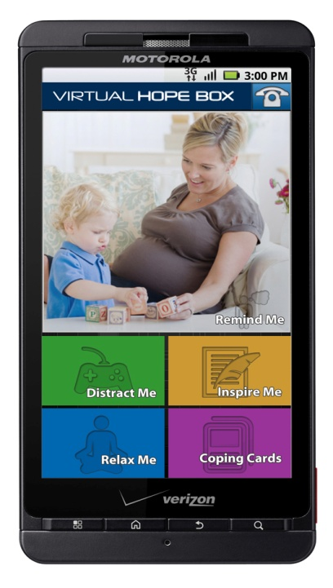
T2 Virtual Hope Box
Focuses the user on cherished memories, reminders in digital media: Photos, videos, recorded messages, music.
User customized support contacts, hotline info.
Preloaded inspirational quotes can be supplemented or replaced by personal quotes, family aphorisms, biblical phrases, etc.
Distraction pieces for the user: Activity Planner, and puzzles/word search games taken from user content.
Relaxation pieces, such as a deep breathing tool, progressive muscle relaxation, etc.
Coping Cards highlight adaptive thoughts and behaviors when in crisis or managing problematic core beliefs.

Slide 15
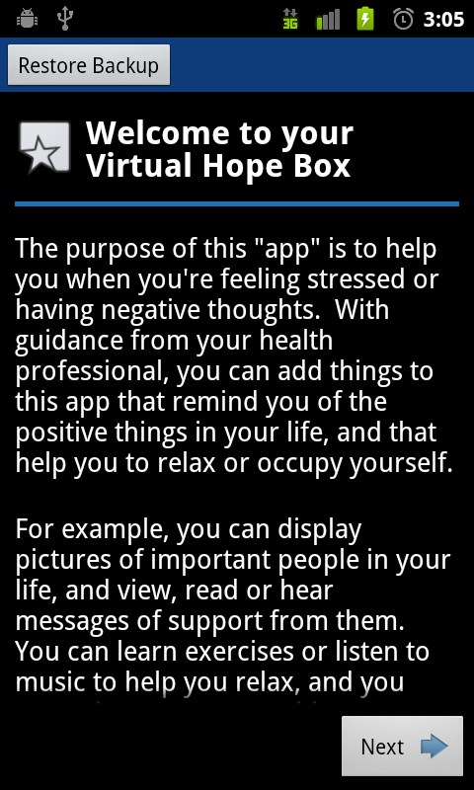
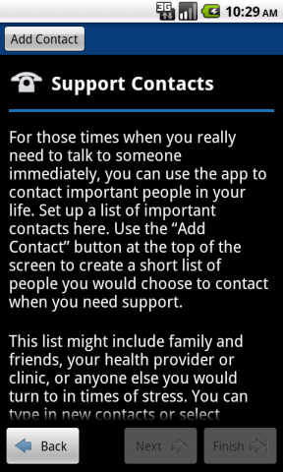
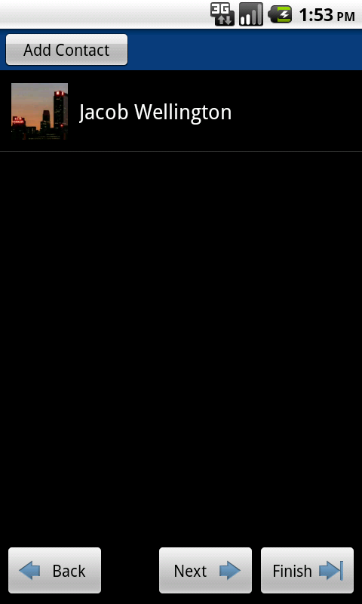
VHB: Construct & Customize
Add supportive contacts from phone’s contact list or create new ones.

Slide 16
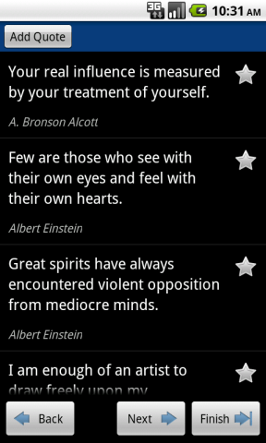
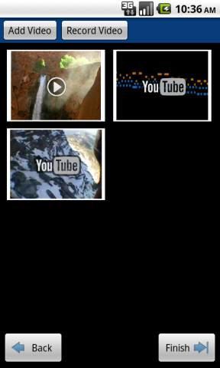
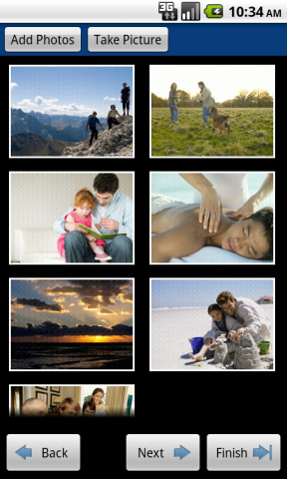
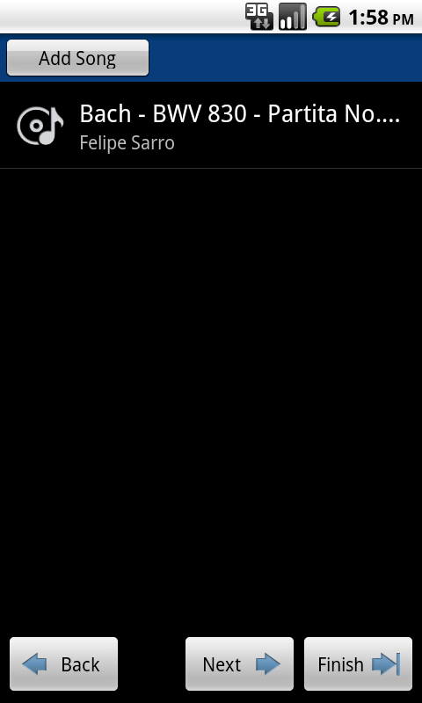
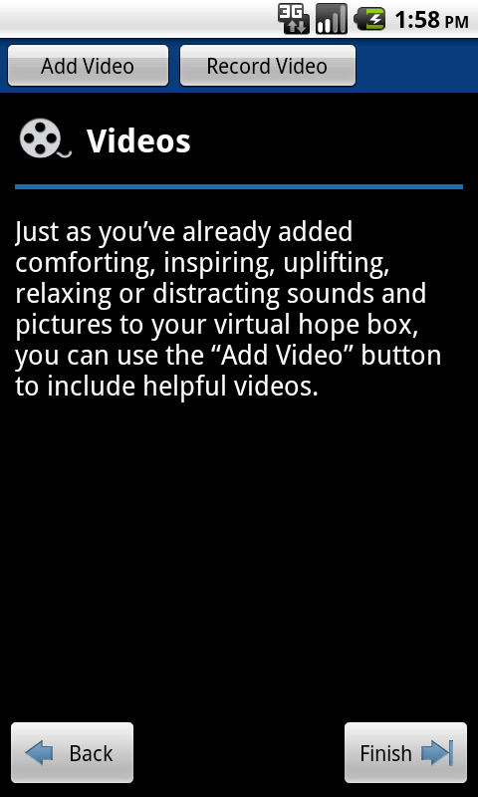
VHB: Construct & Customize (cont.)
Add supportive, comforting, distracting, or relaxing audio, video, pictures, messages, inspirational quotes, or other media.

Slide 17
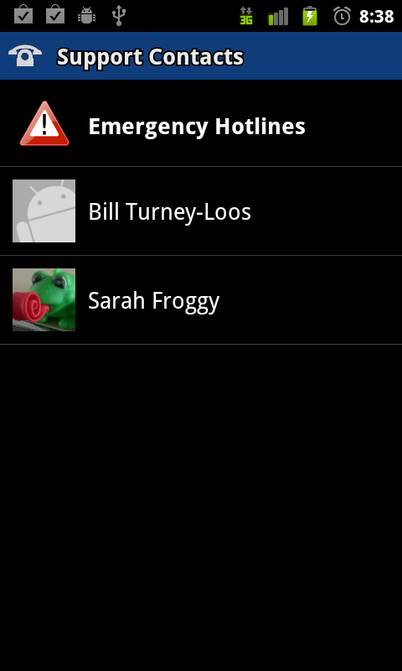
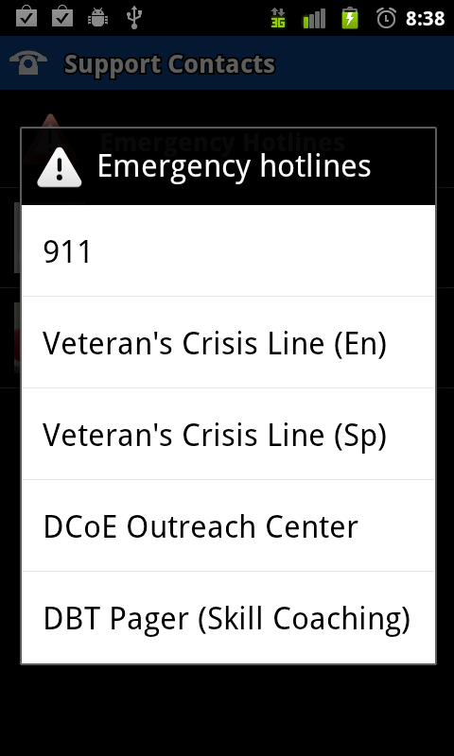
VHB: Support Contacts

Slide 18
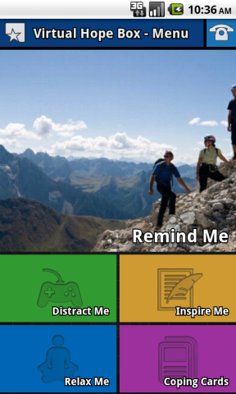
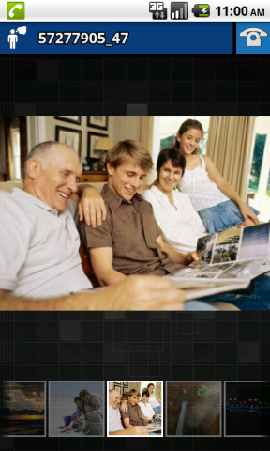
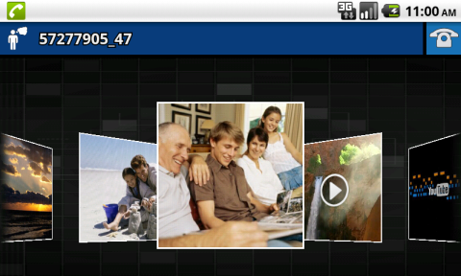
VHB: Remind Me
Select from collection of media in multiple formats. Set Remind Me to shuffle display.

Slide 19
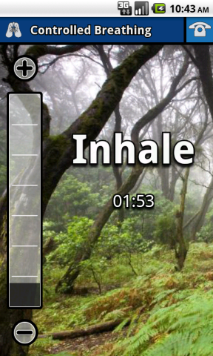
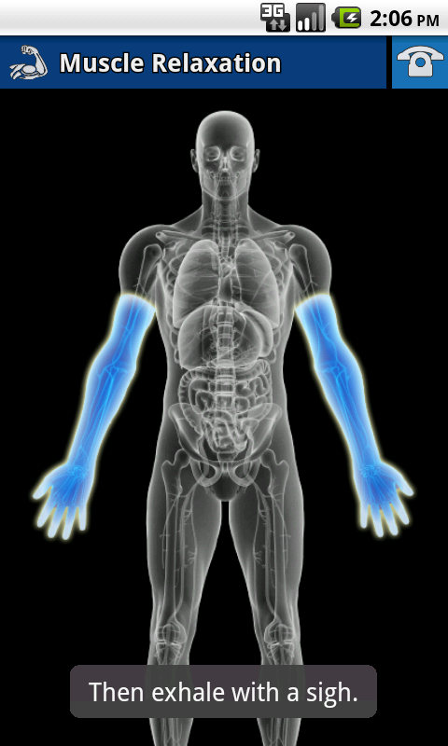
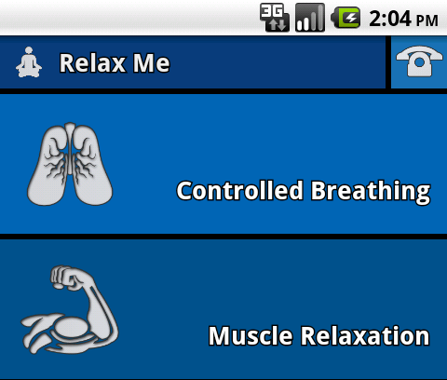
VHB: Relax Me
Selectable timing and duration for inhale, hold, and exhale

Slide 20
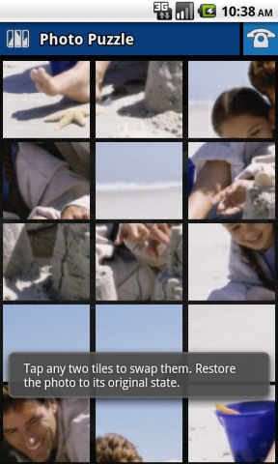
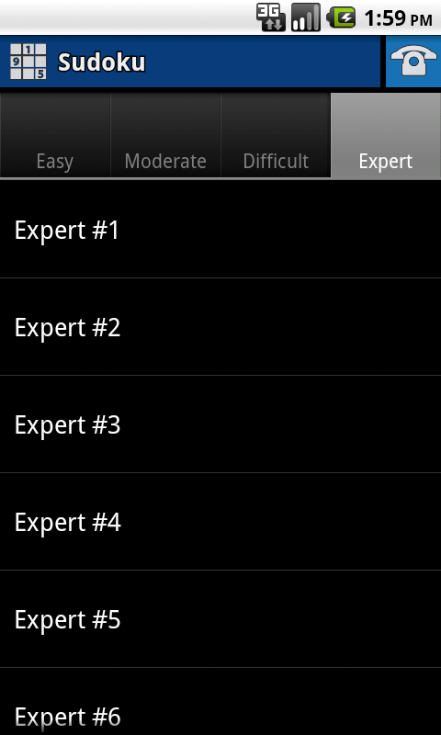
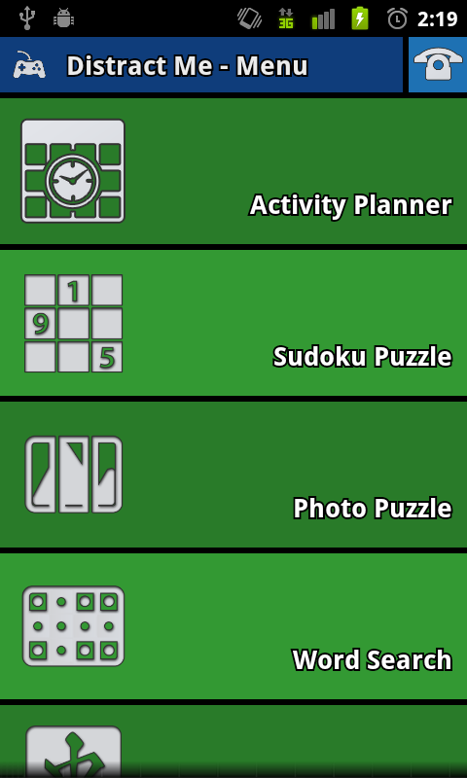
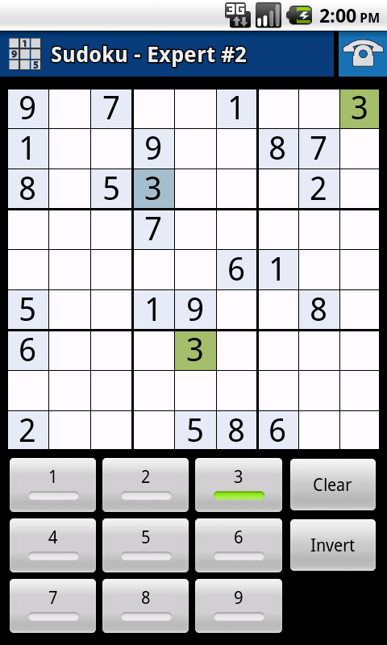
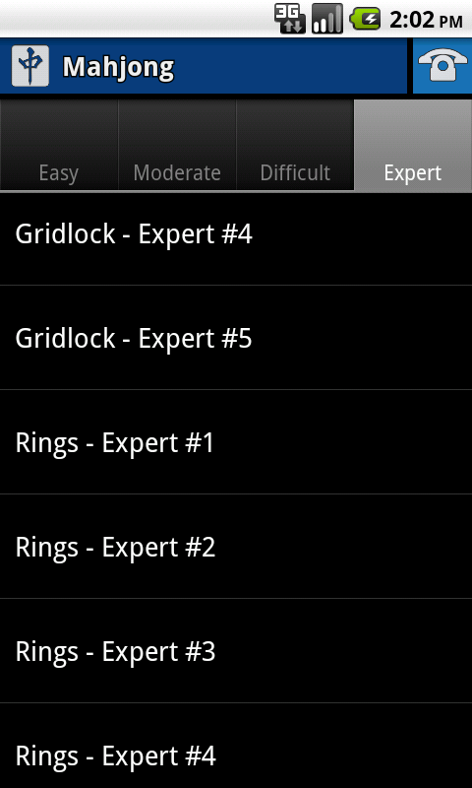
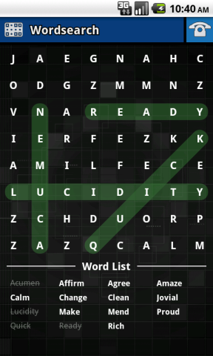
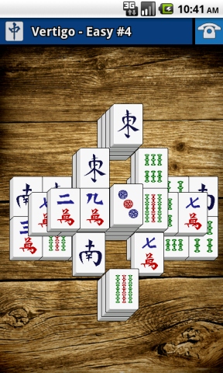
VHB: Distract Me- Games & Puzzles
Puzzle photos and words extracted from user content
Selectable levels of difficulty

Slide 21
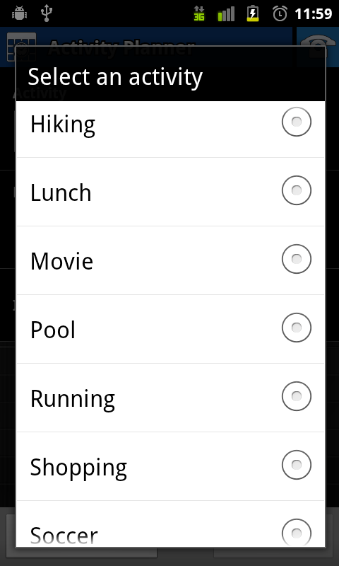
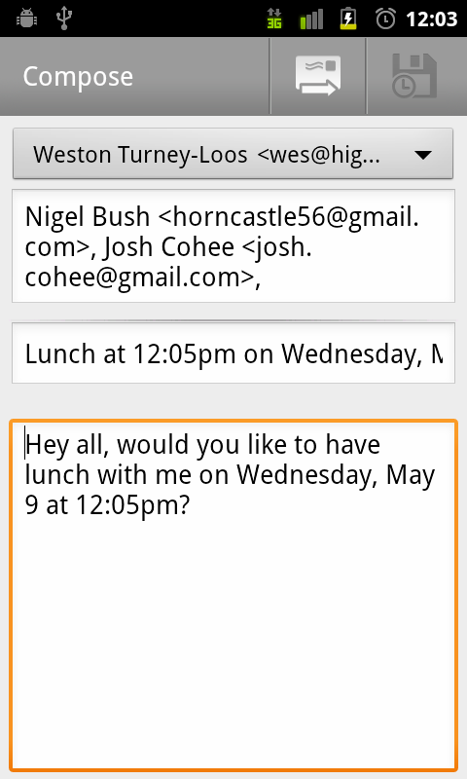
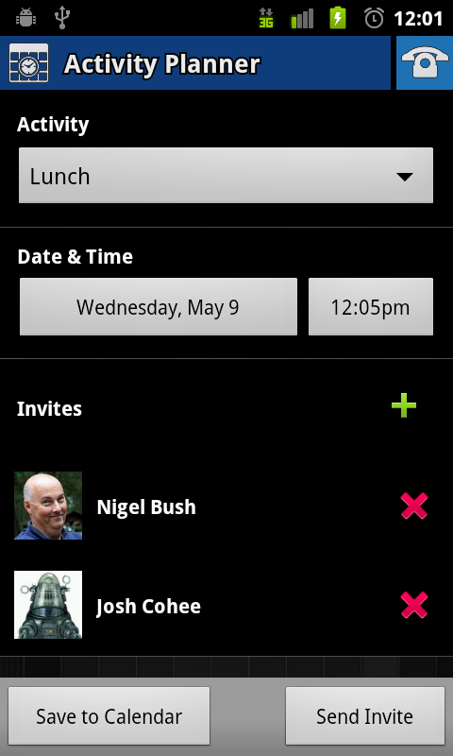
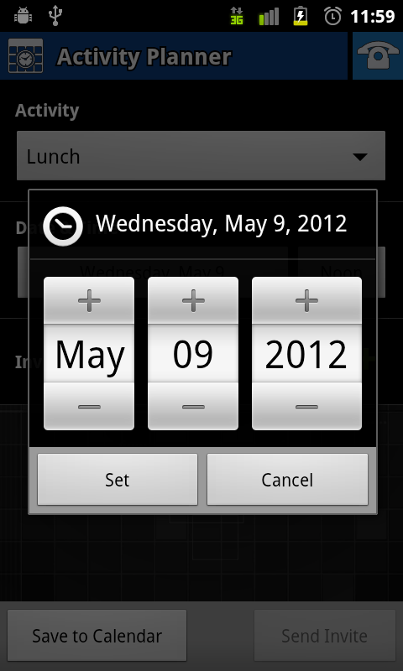
VHB: Distract Me- Activity Planner
Positive Events Scheduling

Slide 22
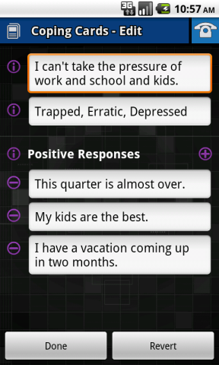
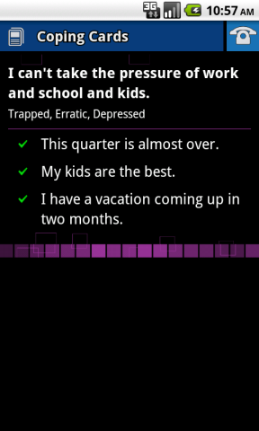
VHB: Coping Cards

Slide 23
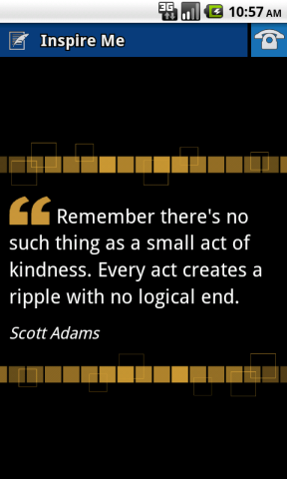
VHB: Inspire Me

Slide 24
Nigel Bush, Ph.D.
nigel.bush@us.army.mil

