Slide 1
Dissemination and Implementation Research
Katherine Anne Comtois, PhD, MPH
Associate Professor
Department of Psychiatry and Behavioral Sciences
University of Washington

Slide 2
Overview
Defining D&I
What makes it different?
Designs and Outcomes
Resources
MSRC D&I Core

Slide 3
Definitions
An effort to communicate tailored information to target audiences with the goal of engagement and information use. (Dissemination is an inherent part of implementation.)
Dissemination
An effort specifically designed to get best practice findings and related products into routine and sustained use through appropriate change/uptake/adoption interventions.
Implementation
Curran, GM, Bauer, M, Mittman, B, Pyne, JM, & Stetler, C. Effectiveness-implementation Hybrid Designs: Combining elements of clinical effectiveness and implementation research to enhance public health impact. Medical Care, 50(3): 217-226

Slide 4
Definitions
What you want to disseminate or implement:
specific clinical/therapeutic practice (eg, use of aspirin after a myocardial infarction)
delivery system/organizational arrangement (eg, chronic care model or new administrative/practice process)
health promotion activity (eg, self-management)
Clinical
Intervention
A method or technique designed to enhance knowledge of or adoption of a “clinical” intervention:
clinical guidelines
policy change
an electronic clinical reminder
marketing campaign
training using a Standardized Patient
Dissemination or Implementation Intervention

Slide 5
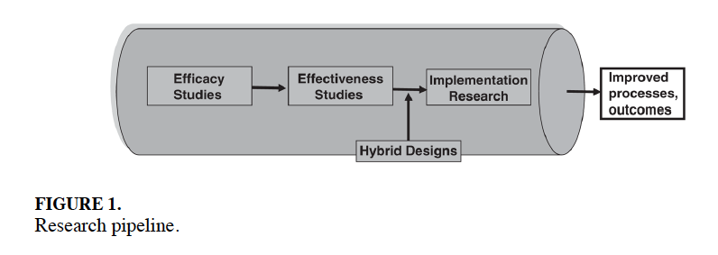
Understanding the Role of D&I Research
Curran, GM, Bauer, M, Mittman, B, Pyne, JM, & Stetler, C. Effectiveness-implementation Hybrid Designs: Combining elements of clinical effectiveness and implementation research to enhance public health impact. Medical Care, 50(3): 217-226

Slide 6
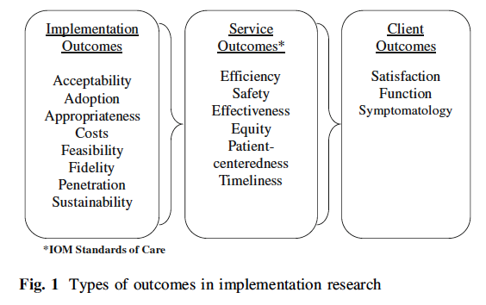
Understanding the Role of D&I Research
Proctor, E., Silmere, H., Raghavan, R., Howmand, P., Aarons, G., Bunger, A., et al. (2010). Outcomes for implementation research: Conceptual distinctions, measurement challenges, and research agenda. Administration and Policy in Mental Health and Mental Health Services Research, 38, 65-76

Slide 7
What are Implementation Outcomes?
Acceptability is the perception among implementation stakeholders that a given treatment, service, practice, or innovation is agreeable, palatable, or satisfactory.
Acceptability
Adoption is deﬁned as the intention, initial decision, or action to try or employ an innovation or evidence-based practice.
Adoption

Slide 8
What are Implementation Outcomes?
Appropriateness is the perceived ﬁt, relevance, or compatibility of the innovation or evidence based practice for a given practice setting, provider, or consumer; and/or perceived ﬁt of the innovation to address a particular issue or problem.
Appropriate-ness
Cost is deﬁned as the cost impact of an implementation effort and depends on costs of:
Clinical intervention
Implementation intervention
Location of service delivery
Cost

Slide 9
What are Implementation Outcomes?
Feasibility is deﬁned as the extent to which a new treatment, or an innovation, can be successfully used or carried out within a given agency or setting
Feasibility
Fidelity is deﬁned as the degree to which an intervention was implemented as it was prescribed in the original protocol or as it was intended by the program developers
Fidelity

Slide 10
What are Implementation Outcomes?
Penetration is deﬁned as the integration of a practice within a service setting and its subsystems
# clients receiving service/# clients eligible
# providers offering service/# providers trained
Reach/
Penetration
Sustainability
Sustainability is deﬁned as the extent to which a newly implemented treatment is maintained or institutionalized within a service setting’s ongoing, stable operations.

Slide 11
Hybrid Type 1 – Primarily Effectiveness Trial
Testing a clinical intervention while gathering information on its delivery during the effectiveness trial and/or on its potential for implementation in a real-world situation.
Hybrid Type 2
You have options
Simultaneous testing of a clinical intervention and an implementation intervention/strategy.
Hybrid Type 3 – Primarily Implementation Trial
Testing an implementation intervention/strategy while observing/gathering information on the clinical intervention and related outcomes.
Curran et al. Effectiveness-implementation Hybrid Designs: Combining elements of clinical effectiveness and implementation research to enhance public health impact. Medical Care, 50(3): 217-226

Slide 13
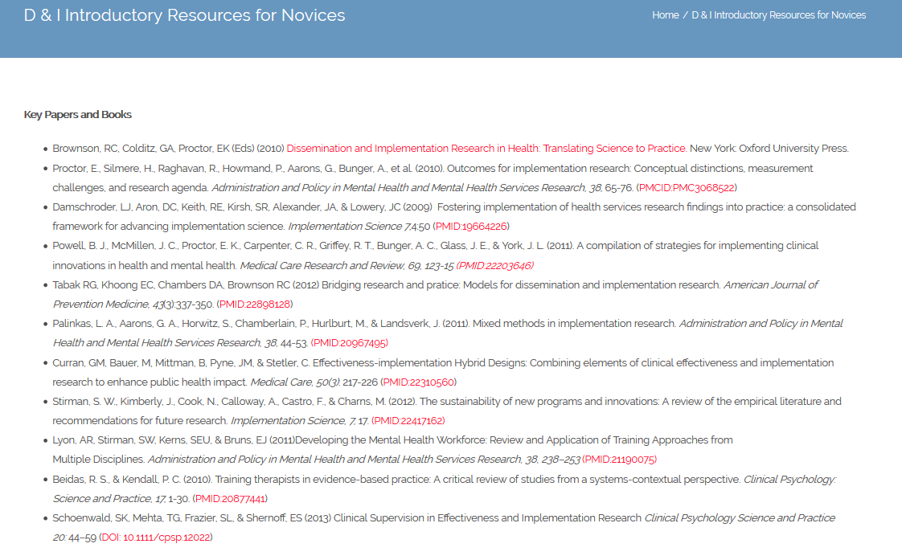

Slide 14
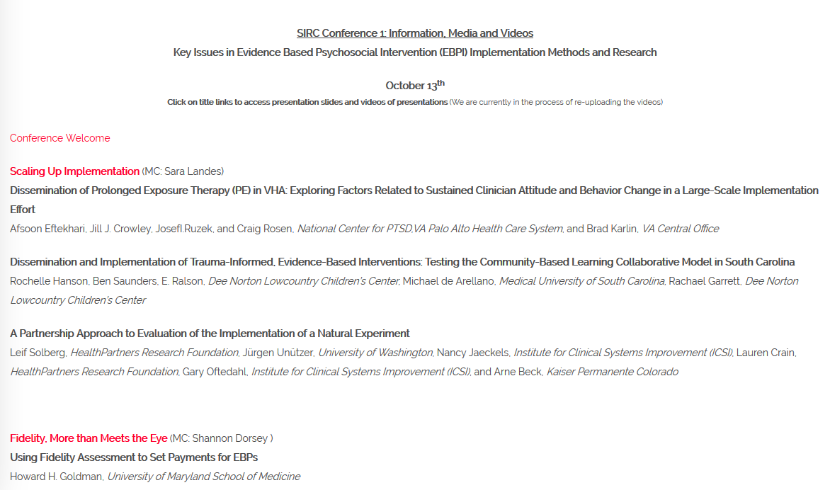

Slide 15
Videos and
Slides Available

Slide 16
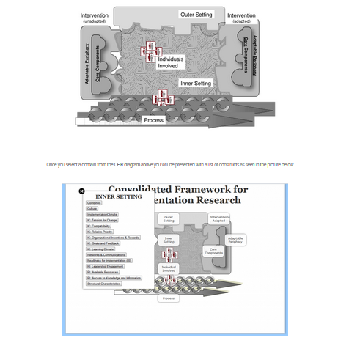
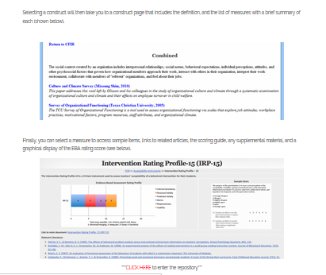
Instrument Repository
Summarizes Key
D&I Instruments

Slide 17
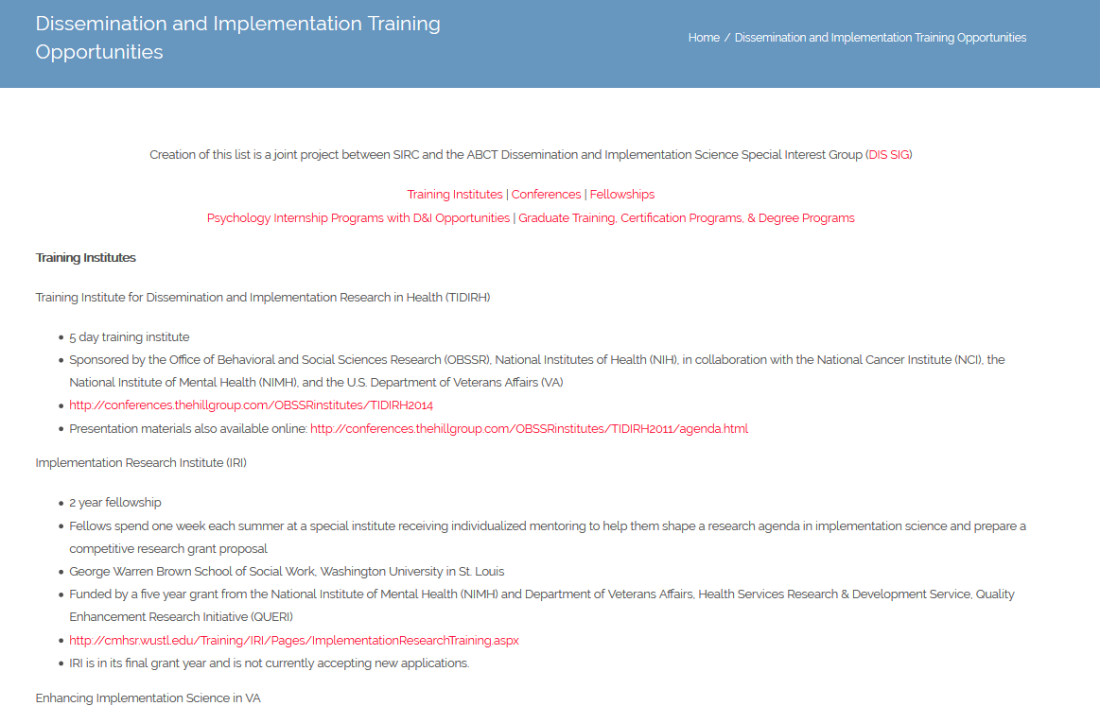

Slide 18
Other Resources

Slide 19
Developing the MSRC D & I Core
MSRC PIs and Trainees
Department of Defense and VHA Contacts, Offices, Clinics, and Installations
Implementation Researchers and Methodologists
Looking for
Synergy

